Slide 1
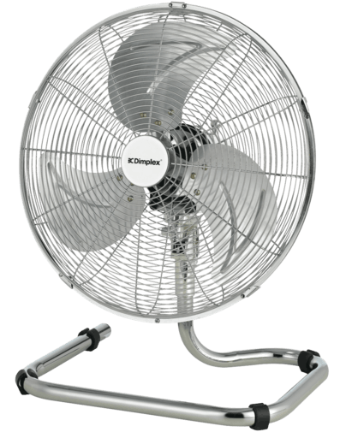
Daily Review
Reminder
Force multipliers: large movement → small movement small input force → large output force Distance multipliers: small movement → large movement large input force → small output force
Is the fan a force or a distance multiplier? Explain your choice.
The fan is a distance multiplier because the small movement from the motor creates a large movement in the blades.

Slide 2
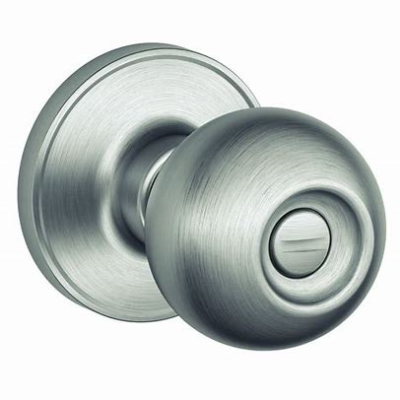
Daily Review
Reminder
Force multipliers: large movement → small movement small input force → large output force Distance multipliers: small movement → large movement large input force → small output force
Is the doorknob a force or distance multiplier? Explain your choice.
The doorknob is a force multiplier because a small force on the outside creates a large force to turn the mechanism.

Slide 3
Simple Machines: Gears Year 7 Science

Slide 4
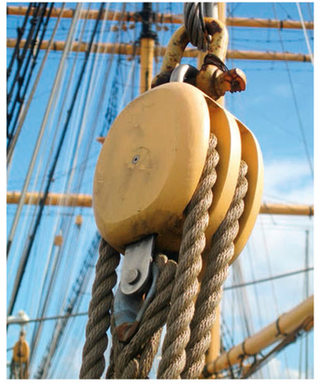
Learning Objectives
CFU
What are we going to learn?
Define and describe gears.
Determine whether gears are force or speed multipliers.
Calculate gear ratios.
Activate Prior Knowledge
Pulleys help us by making it easier to lift a load.
Think, Pair, Share:
List three places where pulleys are used.

Slide 5
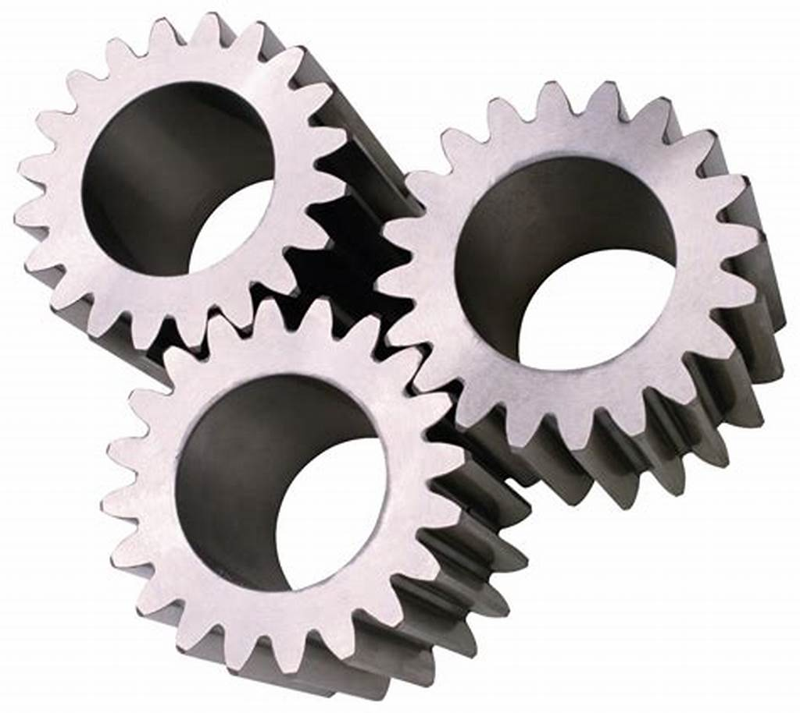
Concept Development
CFU 1
What is a gear?
Gears
Gears are wheels that have teeth around their rim.
The most common type of gears are called spur gears.
Gears can mesh directly together, or be joined by a chain.
They are both speed and force multipliers.
CFU 2
How can gears be positioned?
CFU 3
How is a gear different to a wheel?

Slide 6
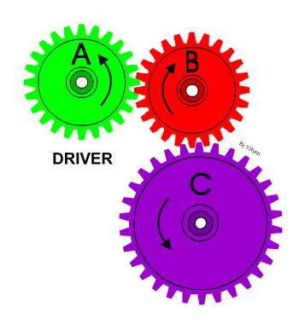
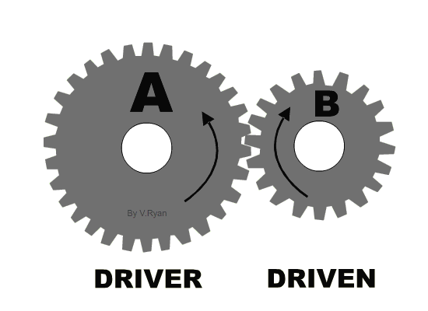
Concept Development
CFU 1
What is a gear train?
Gear Trains
A gear train is a set of gears that are connected.
When one gear turns, the gear it interlocks with turns in the opposite direction.
The gear that supplies the force is called the driving gear.
The gear that is connected to this gear is called the driven gear.
CFU 2
Which gear supplies the force to turn the gear train? driving gear driven gear
CFU 3
Which way do interlocking gears turn? the same direction the opposite direction they don’t turn at all

Slide 7
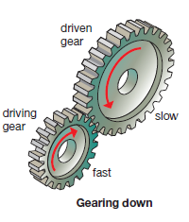
Concept Development
CFU 1
When are gears force multipliers?
Gears as Force Multipliers
If the driving gear is smaller than the driven gear, then the combination acts as a force multiplier.
The larger cog will rotate more slowly, but the force is much larger.
This gear combination is called gearing down and is useful when you need a large force.
It would help a car get up a hill or help in using a winch.
CFU 2
True or False: The larger cog rotates slower in a force multiplier.
CFU 3
When is gearing down useful?
CFU 3
Think, Pair, Share: List two other situations where it is helpful to gear down.

Slide 8
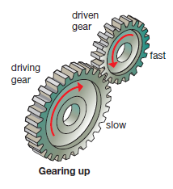
Concept Development
CFU 1
When are gears speed multipliers?
Gears as Speed Multipliers
If the driving gear is larger than the driven gear then the combination acts as a speed multiplier.
One turn of the large cog will make the smaller cog spin a number of times.
This is called gearing up.
It is useful when using an egg beater, where you require the beaters to spin faster than the handle turns.
CFU 2
True or False: The larger cog rotates slower in a speed multiplier.
CFU 3
When is gearing up useful?
CFU 3
Think, Pair, Share: List two other situations where it is helpful to gear up.

Slide 9
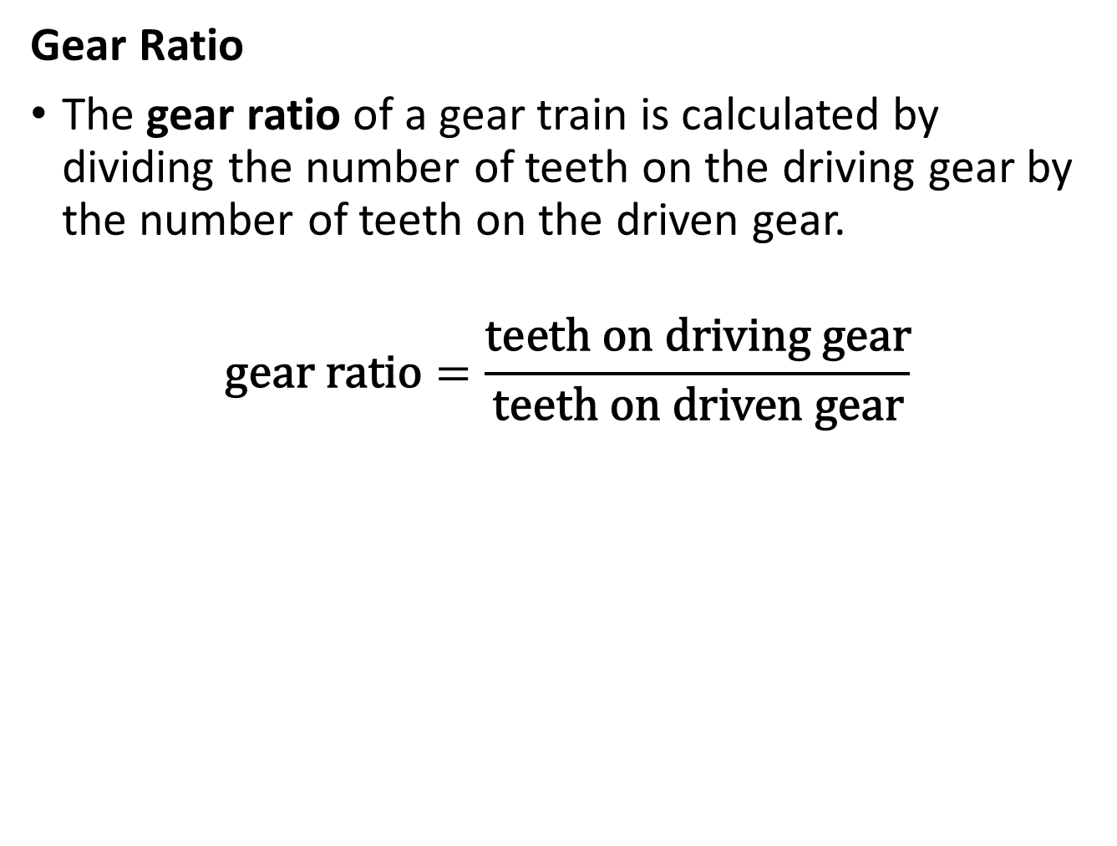
Concept Development
CFU 1
How do you determine the gear ratio of a gear train?
Gear Ratio
The gear ratio of a gear train is calculated by dividing the number of teeth on the driving gear by the number of teeth on the driven gear.
$$\text{gear} \text{ratio}=\frac{\text{teeth} \text{on} \text{driving} \text{gear}}{\text{teeth} \text{on} \text{driven} \text{gear}}$$

Slide 10
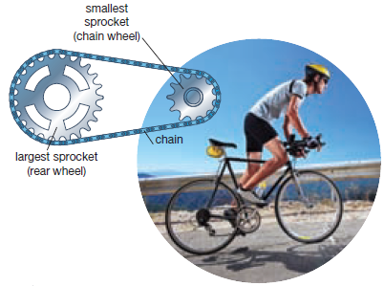
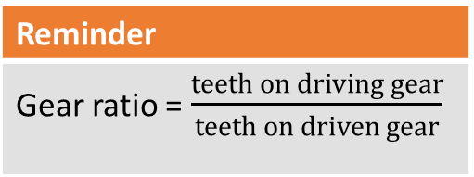
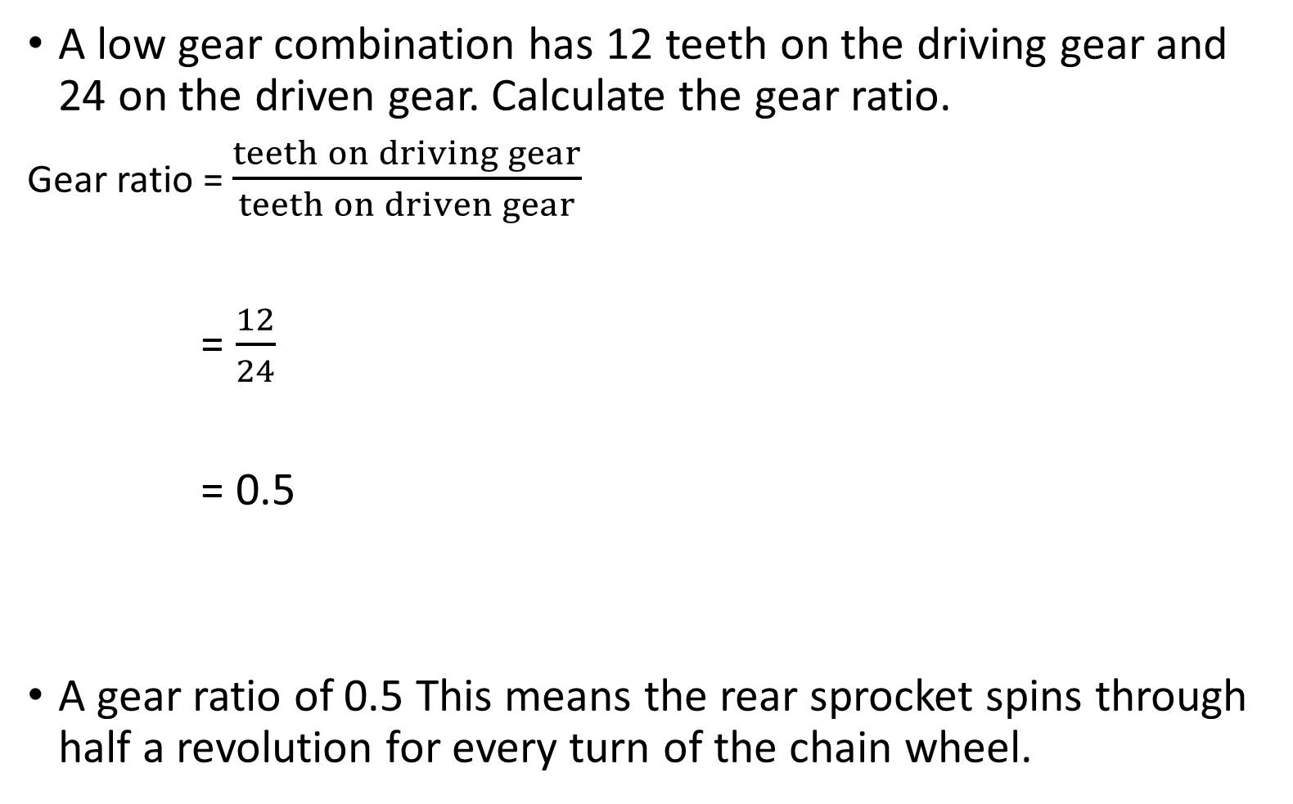
Skill Development / Guided Practice
CFU 1
Is this gear train a force or speed multiplier?
A low gear combination has 12 teeth on the driving gear and 24 on the driven gear. Calculate the gear ratio.
Gear ratio = $\frac{teeth on driving gear}{teeth on driven gear}$
= $\frac{12}{24}$
= 0.5
A gear ratio of 0.5 This means the rear sprocket spins through half a revolution for every turn of the chain wheel.
Reminder
Gear ratio = $\frac{teeth on driving gear}{teeth on driven gear}$

Slide 11
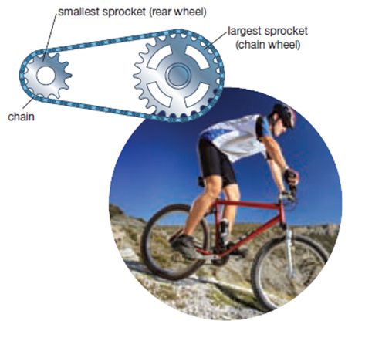
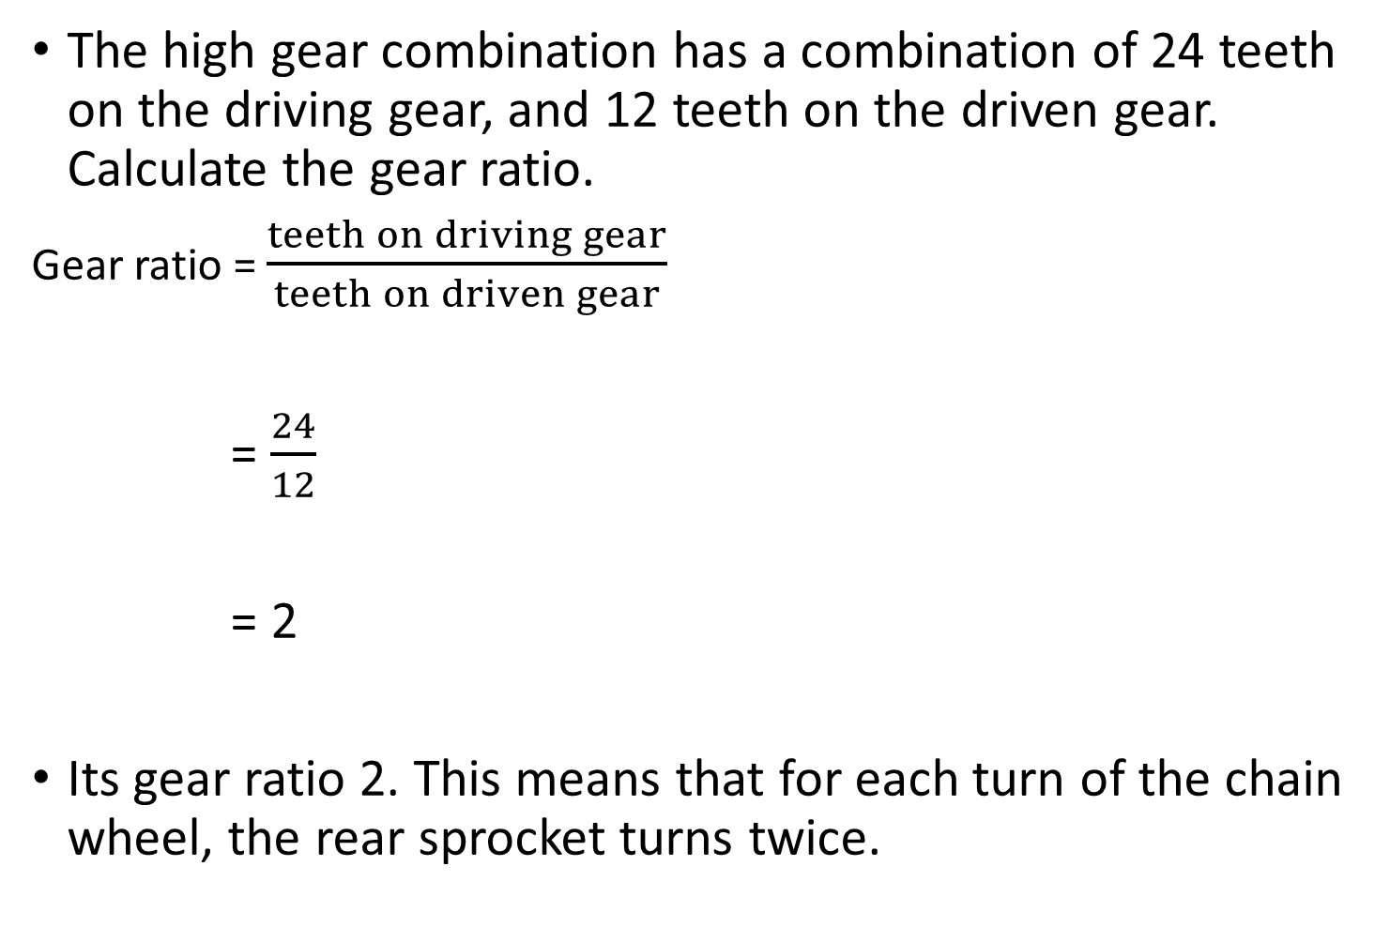
Skill Development / Guided Practice
CFU 1
Is this gear train a force or speed multiplier?
The high gear combination has a combination of 24 teeth on the driving gear, and 12 teeth on the driven gear. Calculate the gear ratio.
Gear ratio = $\frac{teeth on driving gear}{teeth on driven gear}$
= $\frac{24}{12}$
= 2
Its gear ratio 2. This means that for each turn of the chain wheel, the rear sprocket turns twice.
Reminder
Gear ratio = $\frac{teeth on driving gear}{teeth on driven gear}$

Slide 12
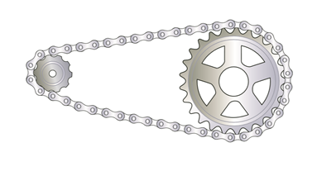
Skill Development / Guided Practice
CFU 1
Which is the driving gear? How many teeth does it have?
Calculate the gear ratio of this gear train. Show your working.
The gear ratio is ______. For every turn of the driving gear, the driven gear is turned ___________. It is a _________ multiplier because the driven gear is ___________ than the driven gear.
The gear ratio is 2.5. For every turn of the driving gear, the driven gear is turned 2.5 times. It is a speed multiplier because the driving gear is larger than the driven gear.
CFU 2
Which is the driven gear? How many teeth does it have?
Driving gear
25 teeth
CFU 3
Is this gear train a speed or force multiplier?
Driven gear
10 teeth
CFU 4
Think, Pair, Share: Describe a situation in which this gear ratio would be useful.

Slide 13
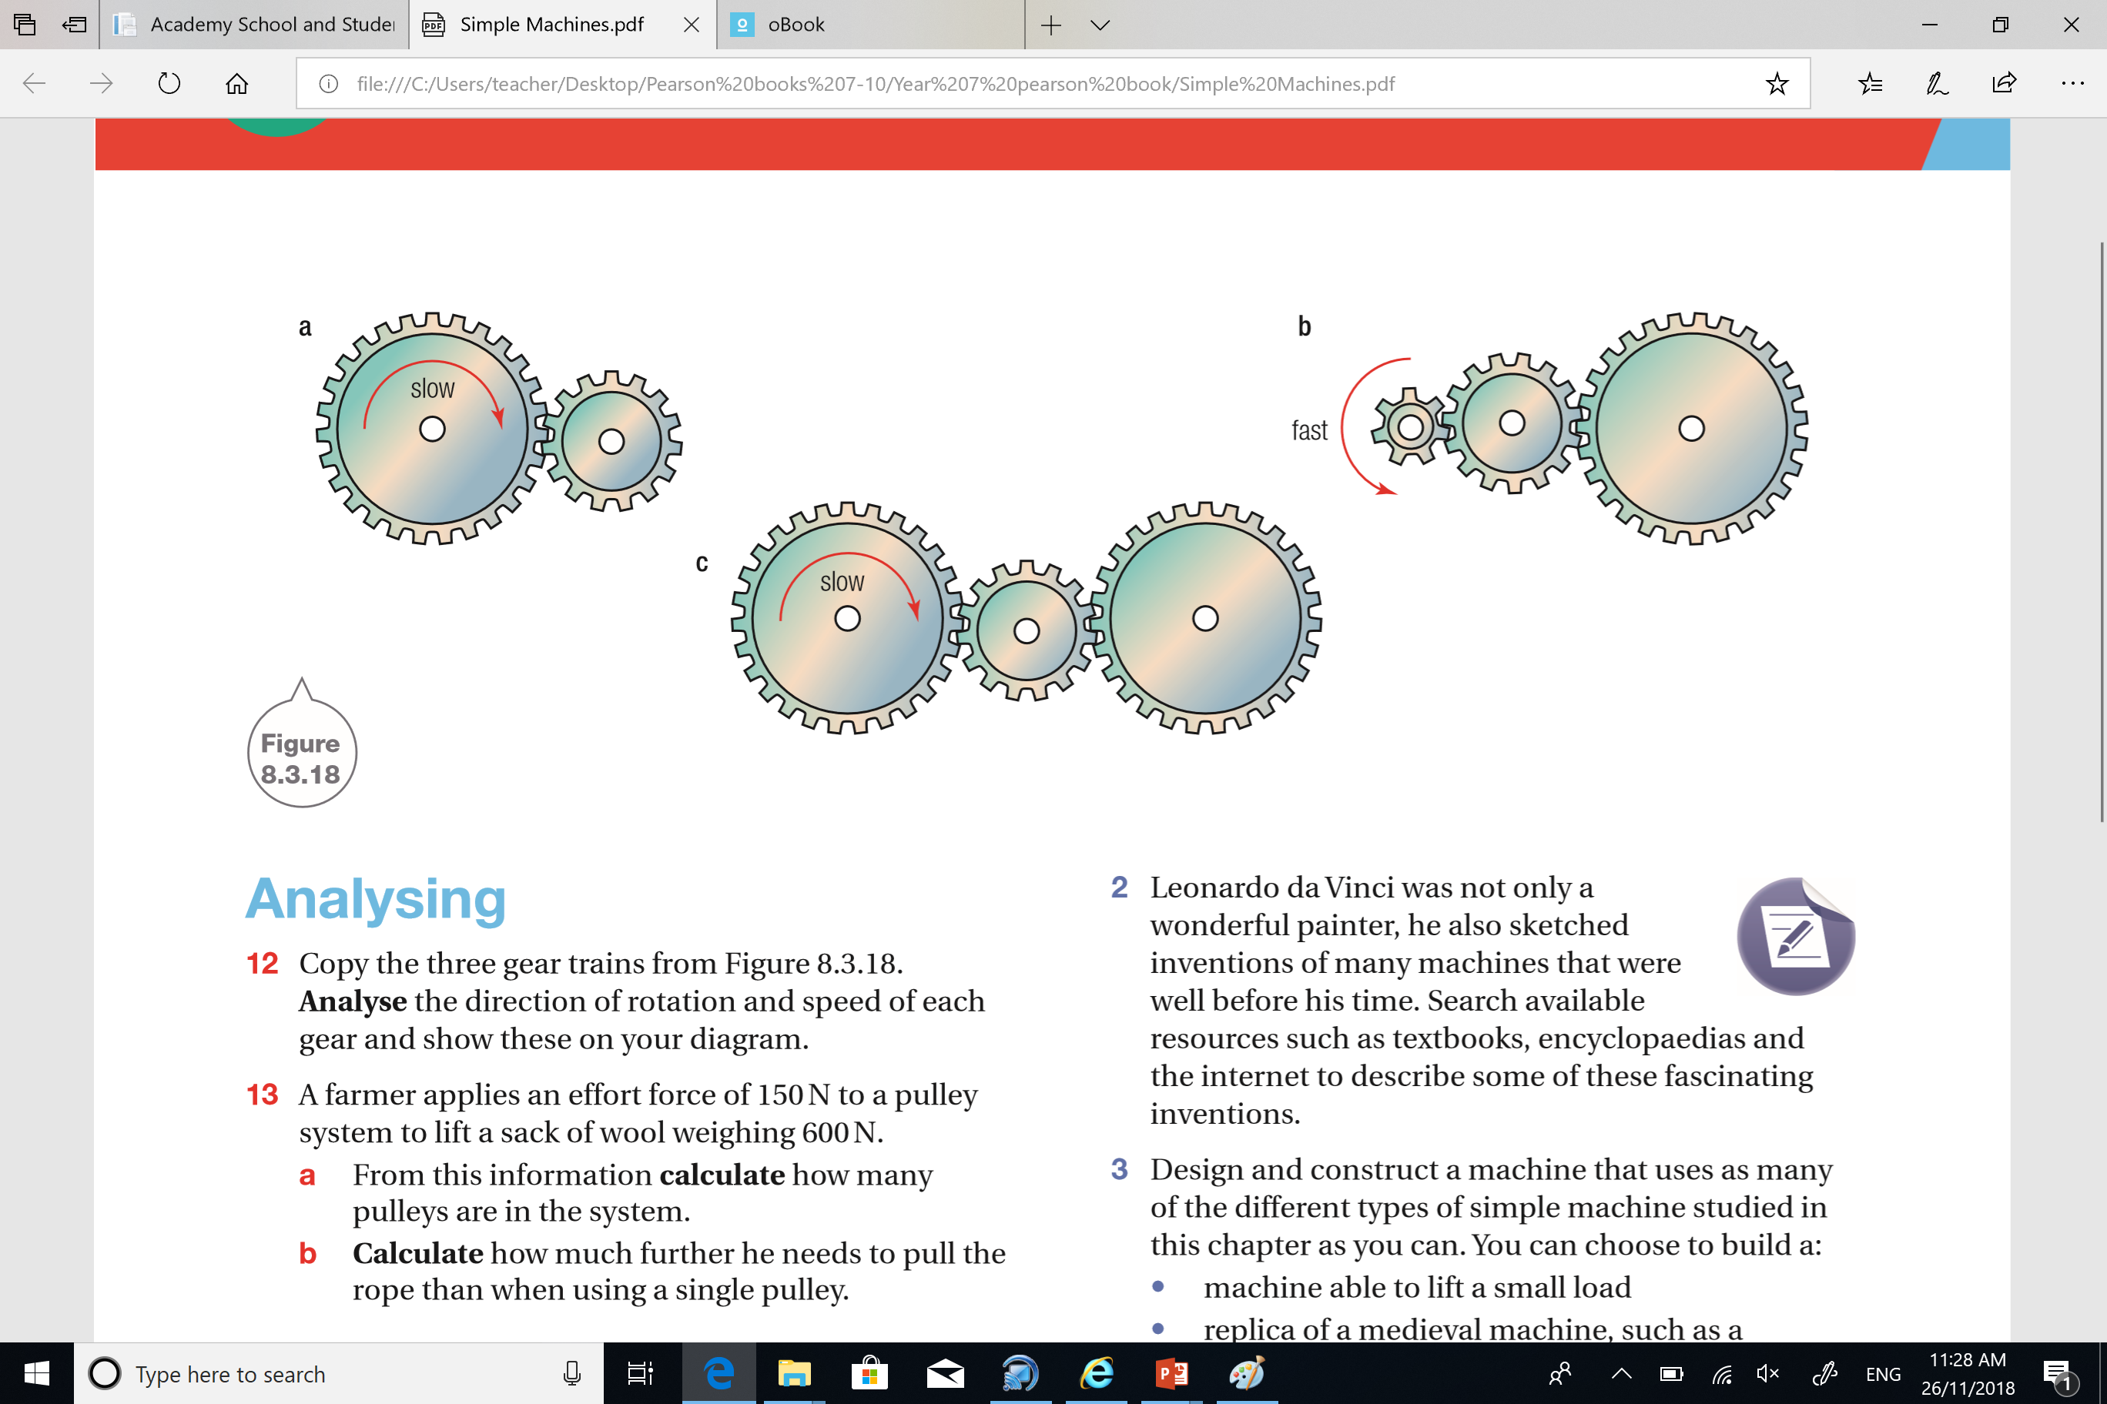
Skill Development / Guided Practice
CFU 1
Which is the driving gear?
Describing Gear Trains
Analyse and describe:
The direction each gear is turning.
The speed of each gear.
CFU 2
Which is the driven gear?
CFU 3
Is this gear train a speed or force multiplier? Why?
A is turning clockwise B is turning anti-clockwise
A is turning slow
B is turning faster
A
CFU 4
Think, Pair, Share: Describe a riding situation in which this gear ratio would be useful.
B

Slide 14
Skill Development / Guided Practice
CFU 1
Which is the driving gear?
Describing Gear Trains
Analyse and describe:
The direction each gear is turning.
The speed of each gear.
CFU 2
Which is the driven gear?
CFU 3
Is this gear train a speed or force multiplier? Why?
C
A
B
A is turning anti-clockwise B is turning clockwise
C is turning anti-clockwise
2. A is turning fast
B is turning slower
C is turning slowest

Slide 15
Skill Development / Guided Practice
CFU 1
Which is the driving gear?
Describing Gear Trains
Analyse and describe:
The direction each gear is turning.
The speed of each gear.
CFU 2
Which is the driven gear?
CFU 3
Is this gear train a speed or force multiplier? Why?
A
C
B
A is turning clockwise B is turning anti-clockwise
C is turning clockwise
2. A is turning slow
B is turning fast
C is turning slow (same speed as A)

Slide 16
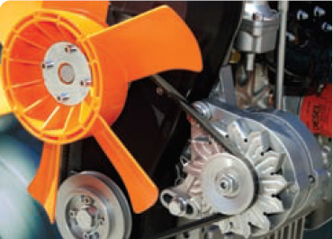
Relevance
Like the other simple machines, gears make our lives much easier.
In some older-style machines such as lathes, one wheel is connected to another wheel by a rubber belt. The belt transfers the spinning motion of the first wheel to the second. The difference in speed depends upon the diameter of each wheel. The fanbelt in a car also operates in this way.
Different combinations of gears are selected to increase either the force applied or the speed of turning.

Slide 17
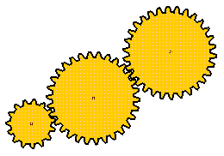
Skill Closure
1. What is a gear train?
2. a. Draw a diagram to show an arrangement of gears in a gear train to act as a:
i) force multiplier
ii) speed multiplier.
3. In the gear train below, the small gear is the driving gear and is turning clockwise
Analyse and describe:
i) The direction each gear is turning.
ii) The speed of each gear.
4. Name three inventions which use gears.

Slide 18
Independent Practice
Collect and complete the Gears worksheet.

